Slide 1



BREAST CANCER PREDICTION USING MACHINE LEARNING ALGORITHMS
HIMA BINDU DESALANKA- 700739704
DEEPIKA RANI GOKAVARAPU - 700740599
MOUNIKA MOTUPALLY - 700741855

Slide 2
ROLES AND RESPONSIBILITIES
Hima worked on documentation, Logistic Regression algorithm. Worked on the motivation, related works, reference part of the paper and also took part in ppt as well.
Deepika worked on DataSet gathering. Worked on the Decision Tree and KNN algorithms. Worked on writing the objectives, main contributions, related work, and experimentation and results for the paper
Mounika worked on the SVM algorithm, worked on the abstract, the introduction, and the proposed framework of the paper.
We together worked as team and got everything figured out.

Slide 3
MOTIVATION
Machine learning algorithms are able to learn from enormous data sets and recognize complicated patterns that may not be immediately apparent to people
Early identification improves survival rates and prevents loss of life from Breast Cancer
Patients will be aware of Breast cancer in the starting stage itself by using our model
Breast cancer costs both patients and health care institutions a lot of money. We can enable early intervention and therapy therefore it reduces the total cost of care by creating precise prediction models.
By combining our technical knowledge with the desire to enhance health care outcomes, we can play critical part in fight against breast cancer

Slide 4
OBJECTIVES
We can predict whether the patients are suffering from breast cancer or not.
Based on independent variables it predicts the stage of Breast Cancer i.e benign or malignant.
Patients will be aware of breast cancer in the starting stage itself.
Decreases the financial burden on patients
Less time consuming.

Slide 5
RELATED WORK:
Azar et al.'s innovative method for finding breast cancer was proposed. The method made use of the radial basis function, probabilistic neural networks, and multi-layer perceptron classification methods. For training and testing, MLP's accuracy was 97.80% and 97.66%, respectively.
To detect breast cancer, a system based on non-contact, non-invasive screening technology was suggested. Their solution made use of the support vector machine classifier and four features. The accuracy of the suggested model was 83.3%.
Using the data mining tool WEKA, Tanaya Padhi et al. examined the prediction of breast cancer. The data mining phases that were used on the dataset were defined in the paper and an accuracy of 72.02%.

Slide 6
Problem statement
We took a data set from Kaggle with the information of the patients diagnosed with Breast Cancer.
The data set also has the target variable which is M/B.
M - Malignant (The tumor is cancerous)
B- Benign ( The tumor is non-cancerous)
The goal of this paper is to use different ML algorithms and find which algorithm gives the best accuracy.
The ML algorithms used are:
Logistic Regression
KNN Classifier
Decision Tree Classifier
Support Vector Machine (SVM)
The accuracy values are calculated for all the algorithms

Slide 7
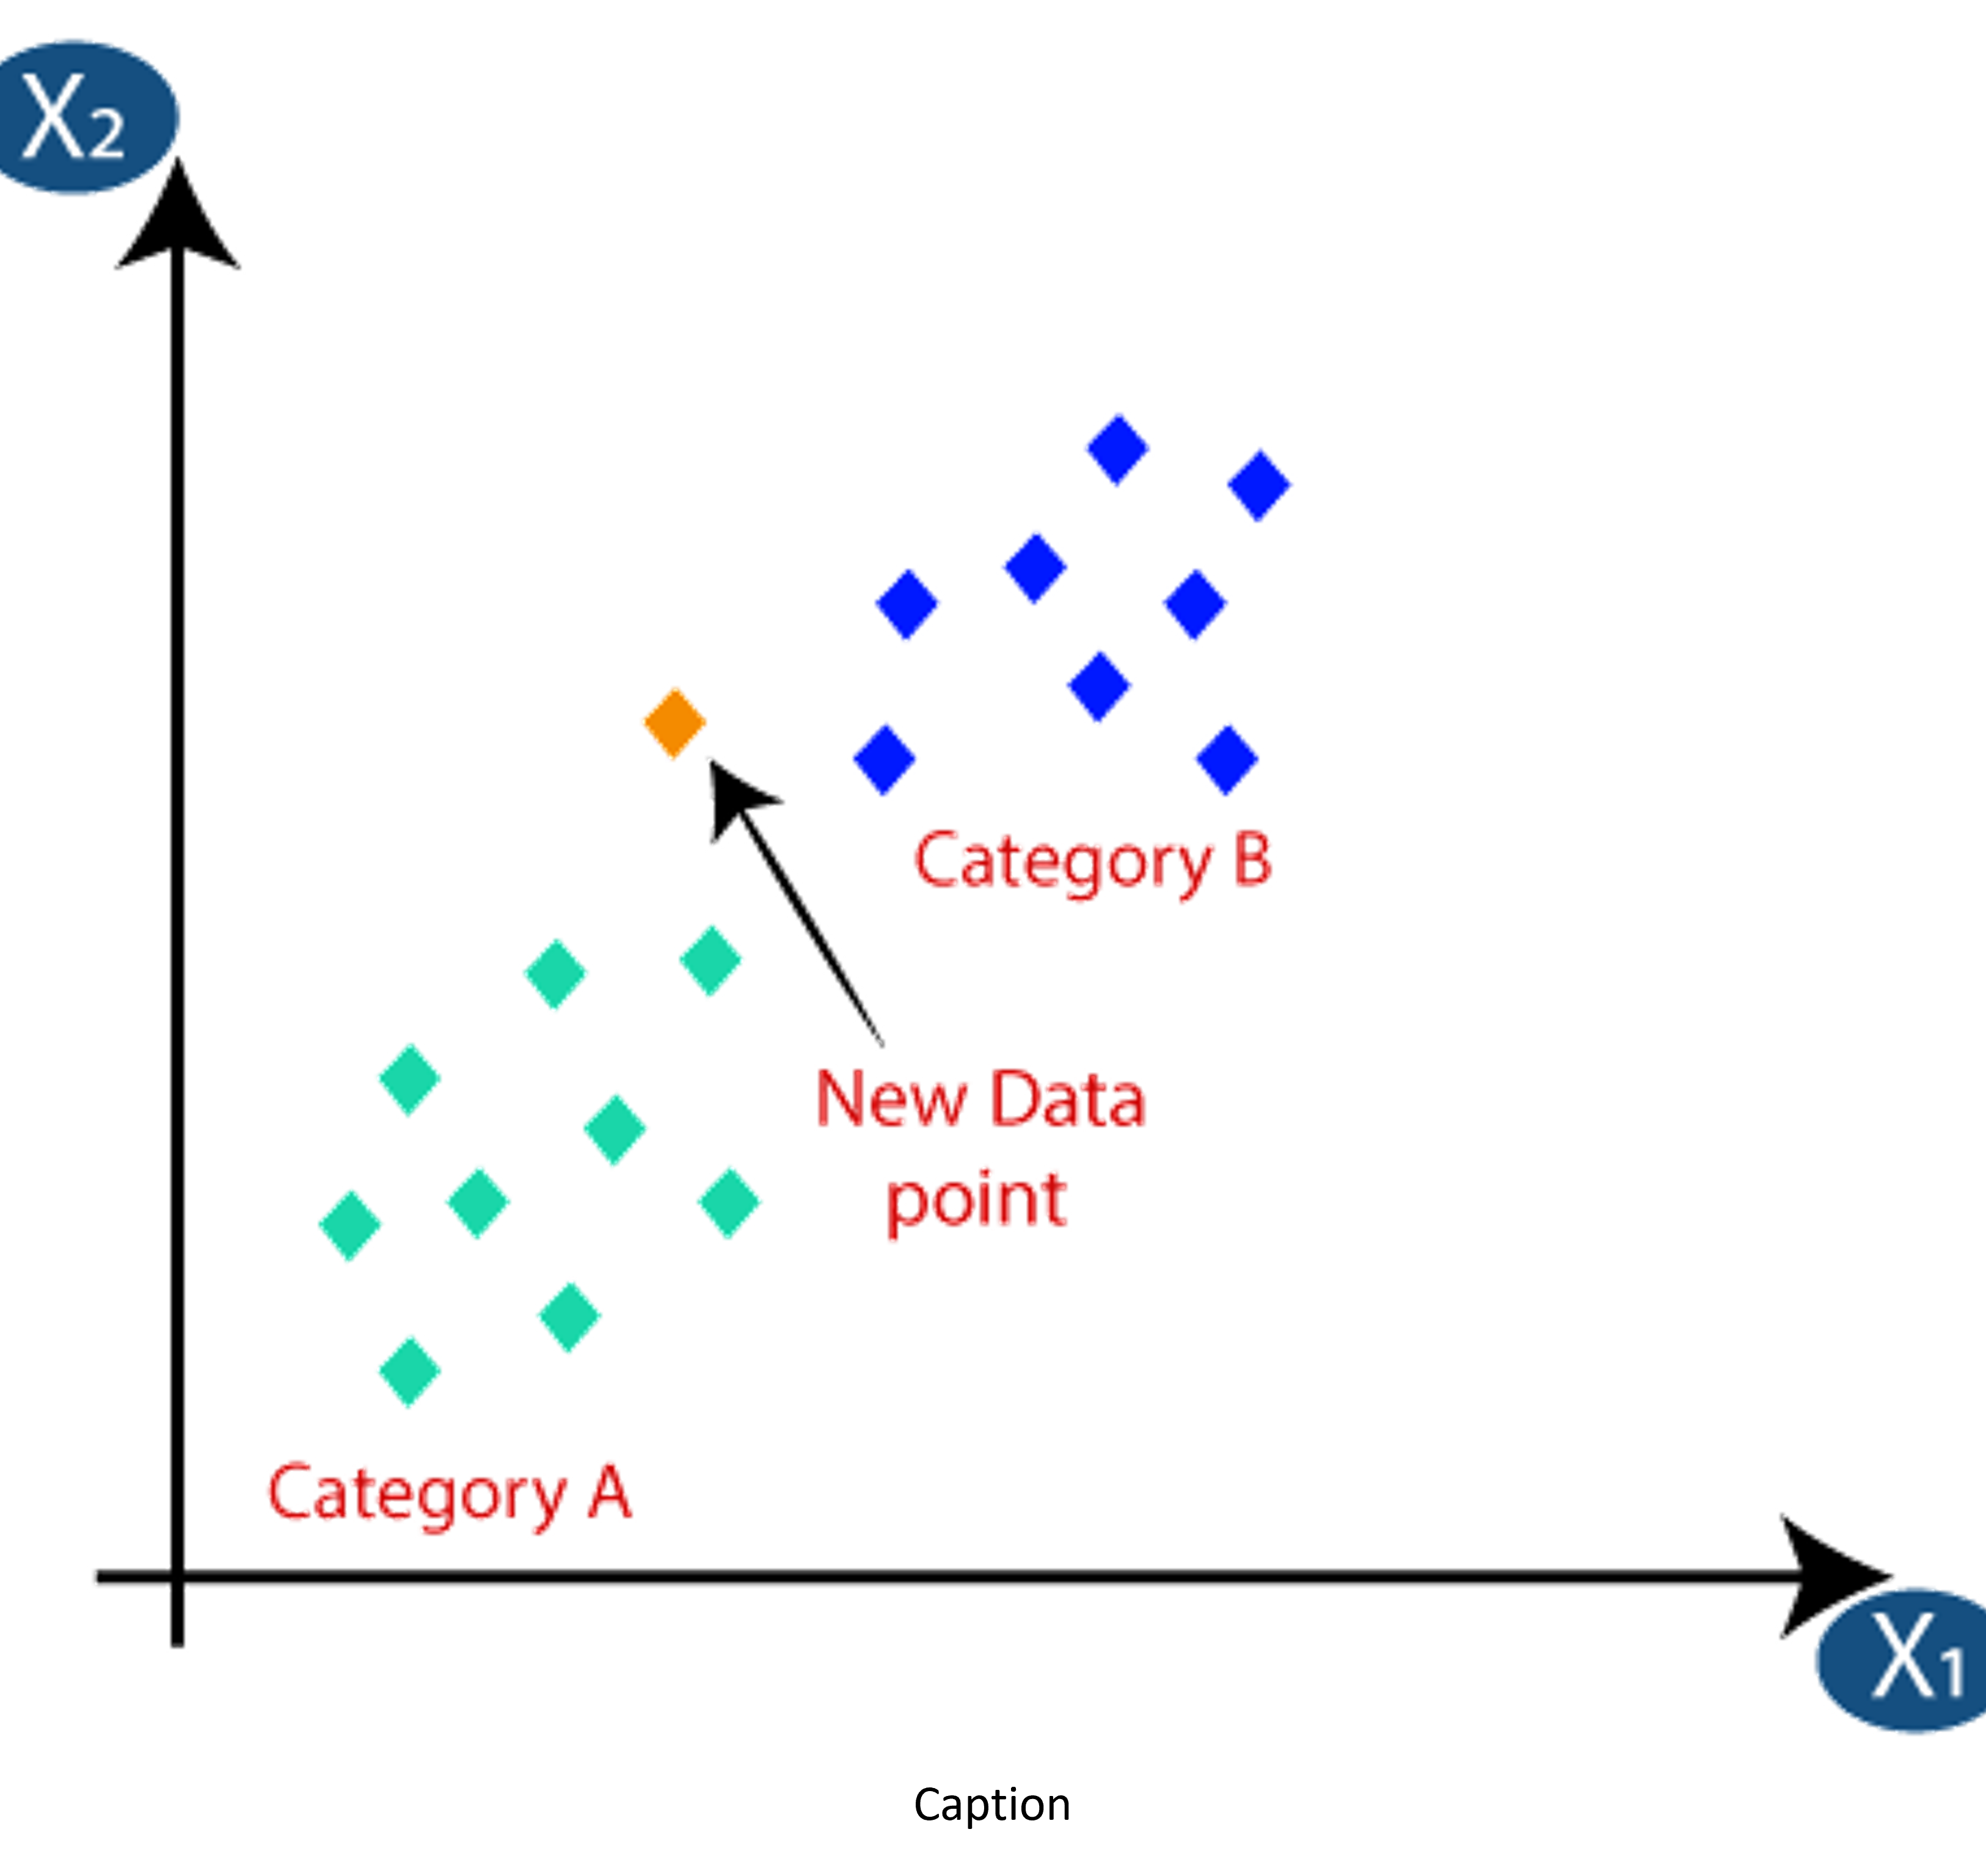
K-Nearing Neighbors Algorithm
For a data point, every other data point is a neighbor.
The distance from a data point to all its neighbors is calculated.
The class of the maximum number of neighbors out of K number of neighbors is predicted as the class for the data point.
We generally take odd value for K.

Slide 8
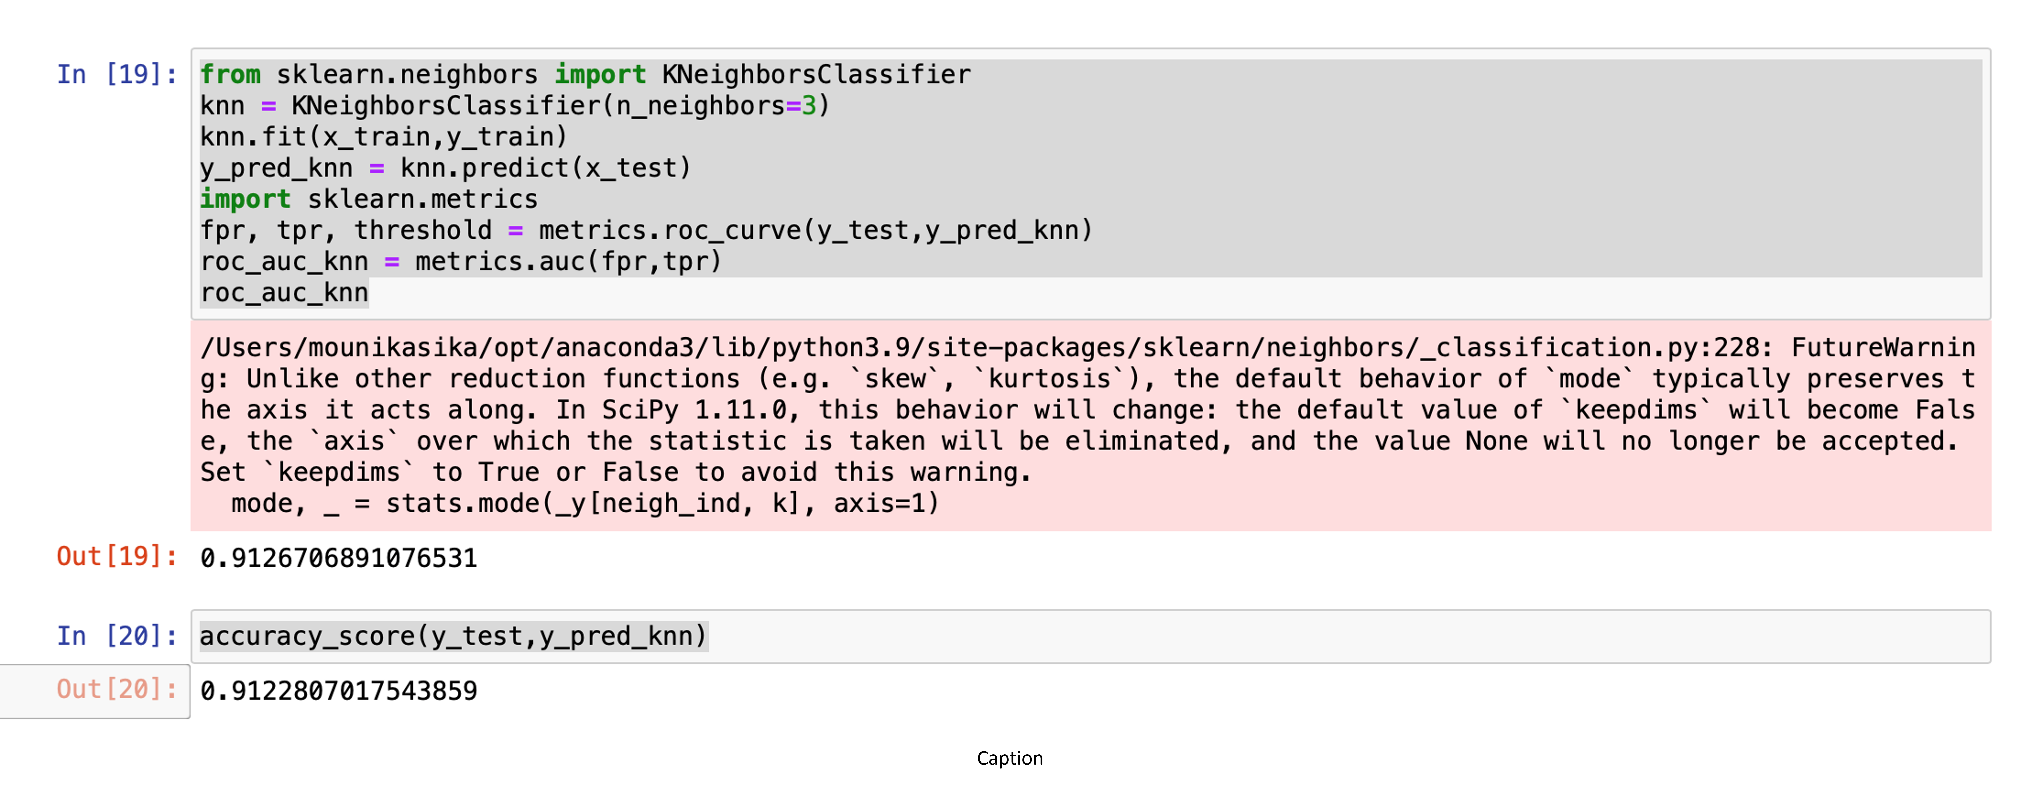
We are seeing an accuracy of 91.26%% with the KNN classifier.

Slide 9
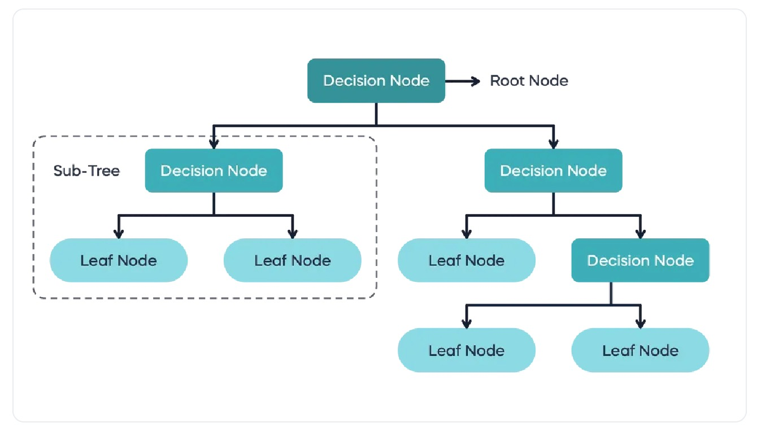
Decision Tree Algorithm
In this algorithm, we create a tree structure/model to predict a target variable.
The main data is divided into sub-data called sub-trees and check the purity of the sub-tree.
We calculate entropy at each level.
We also calculated the information gain and compare the results for each subtree and make a decision on taking a decision on the given input/test data.

Slide 10
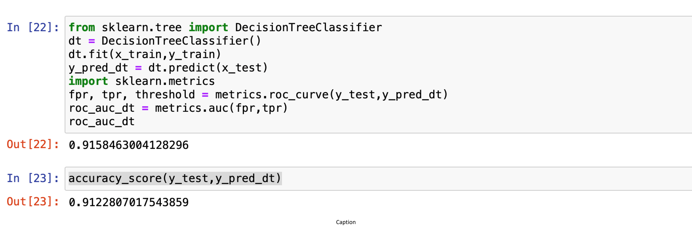
The decision Tree is seen to have an accuracy score of 91.22% for this data set

Slide 11
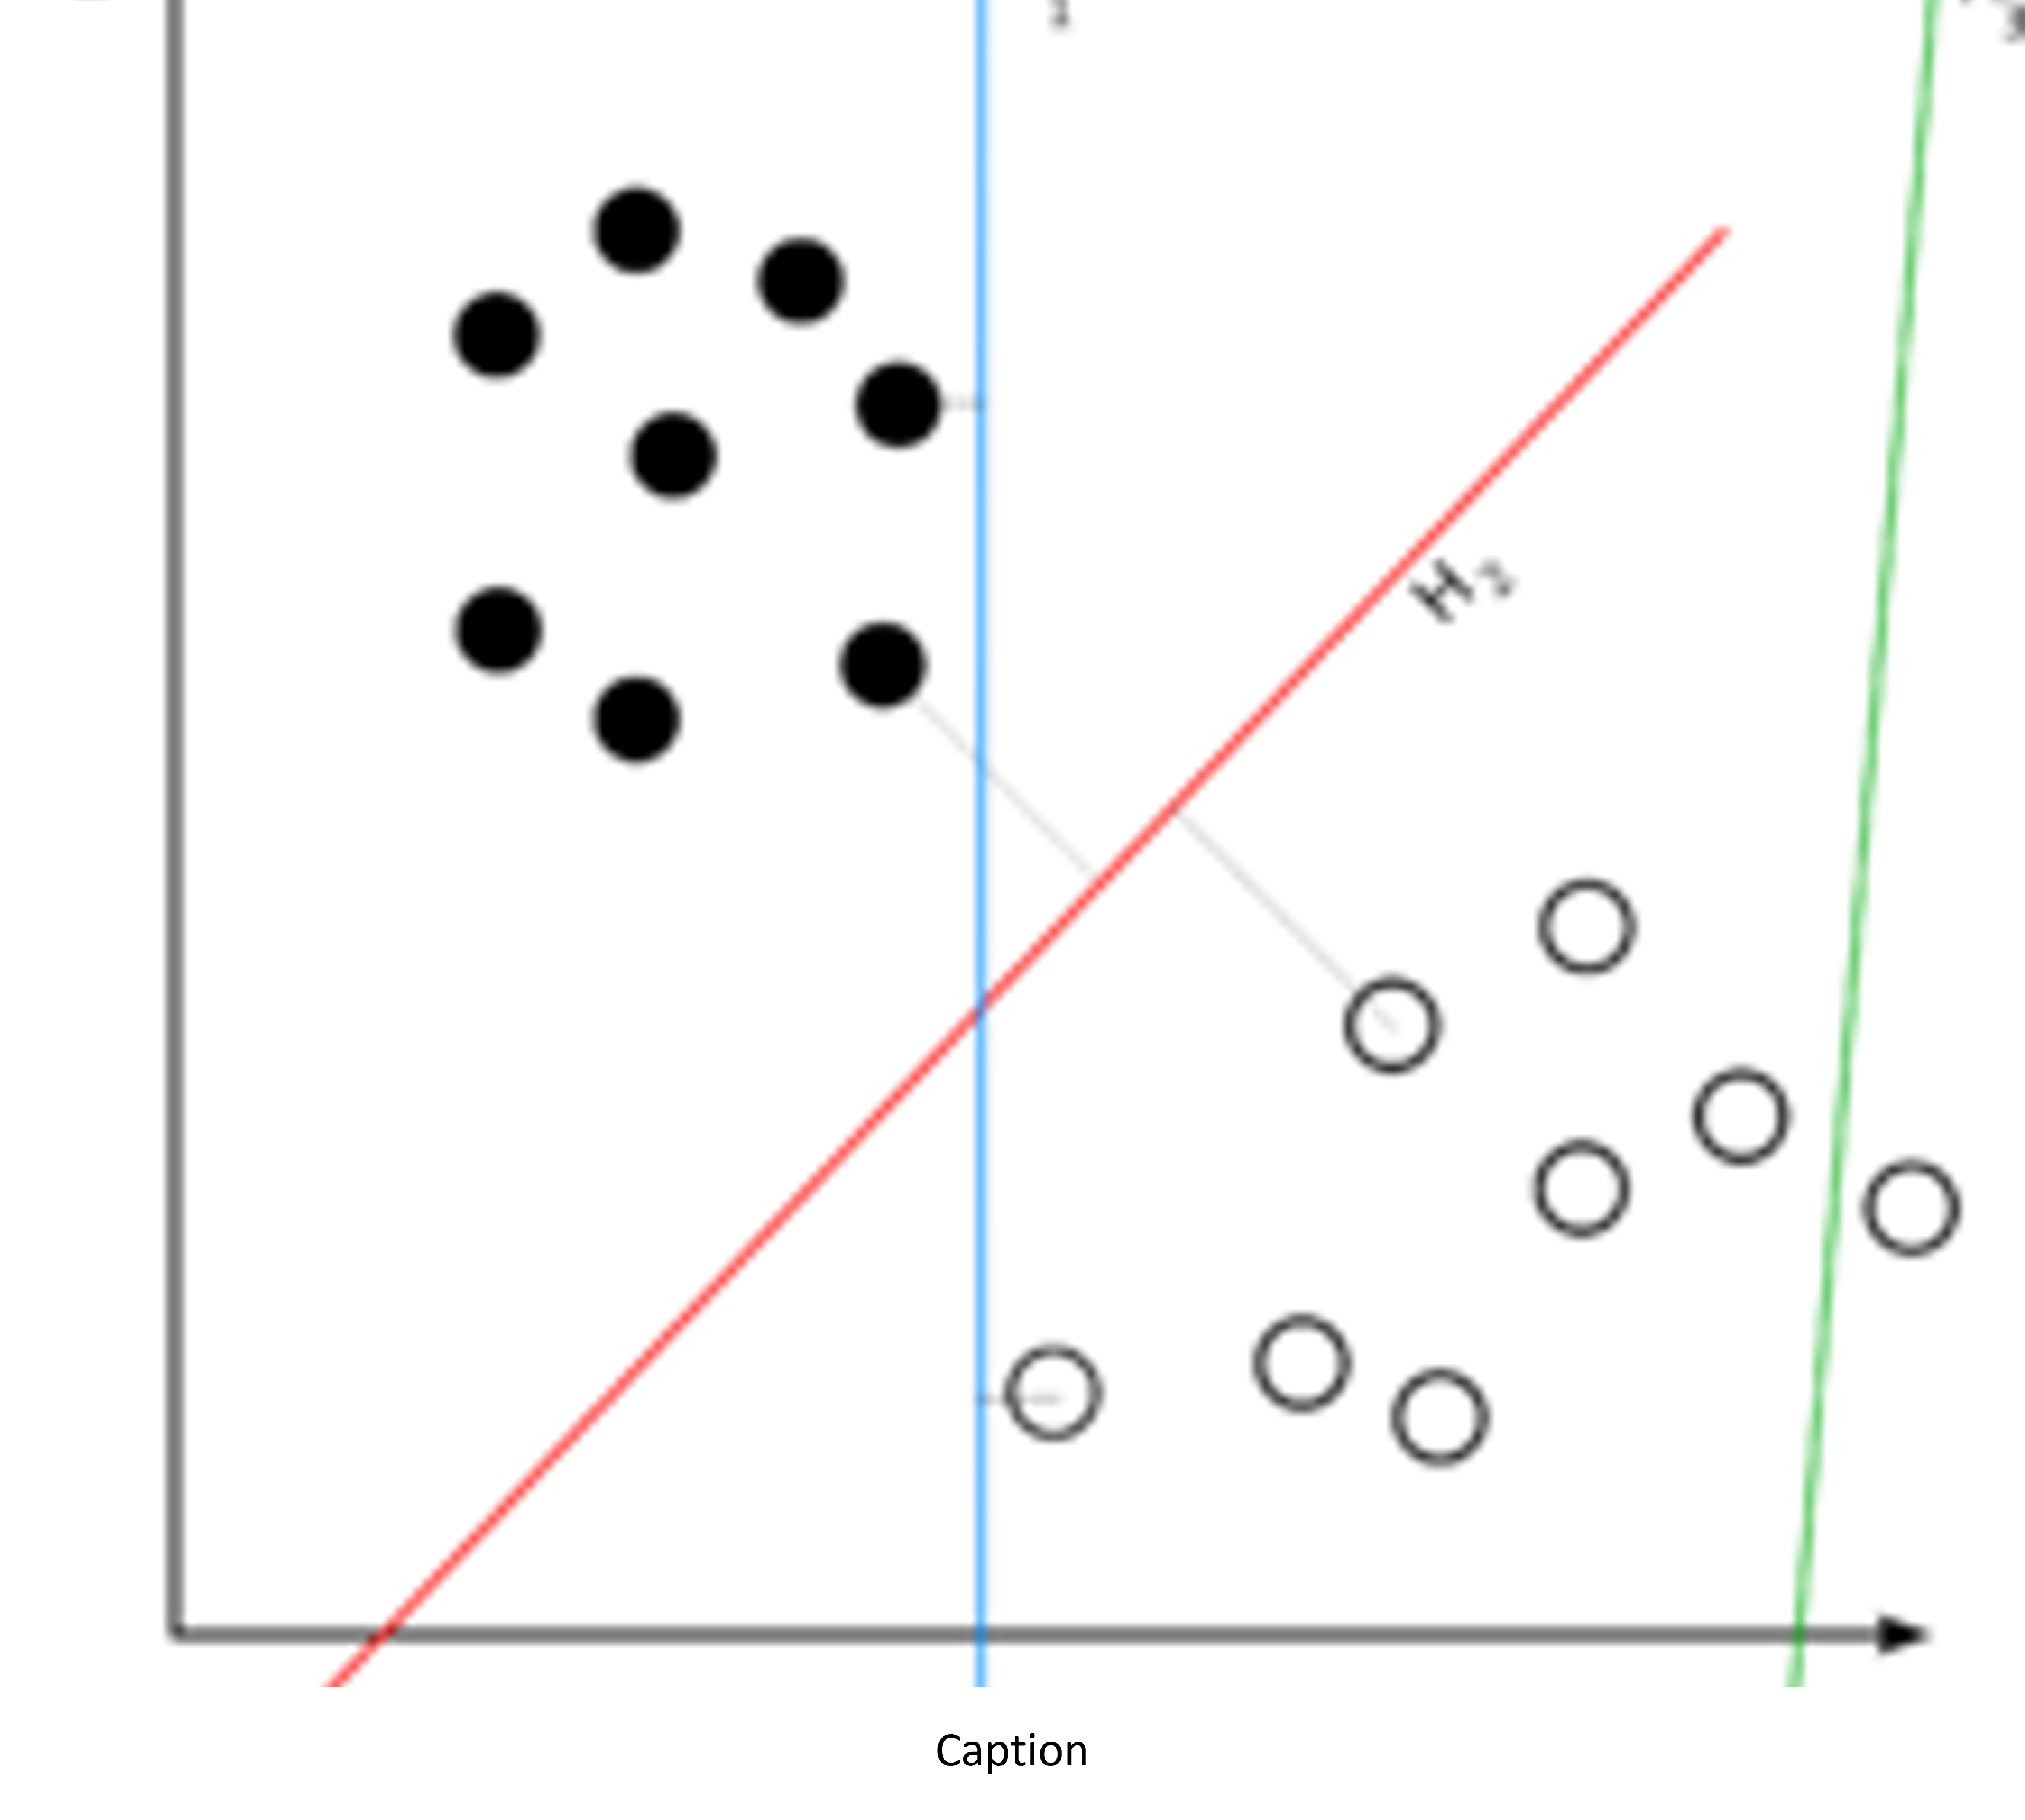
LOGISTIC REGRESSION
The problems are linearly separable
Examples:
Logistic Regression algorithm
Naive Bayes algorithm
KNN classifier algorithm
Logistic Regression
In this, we try to add one or more independent variables of the data set and try to create a boundary.

Slide 12
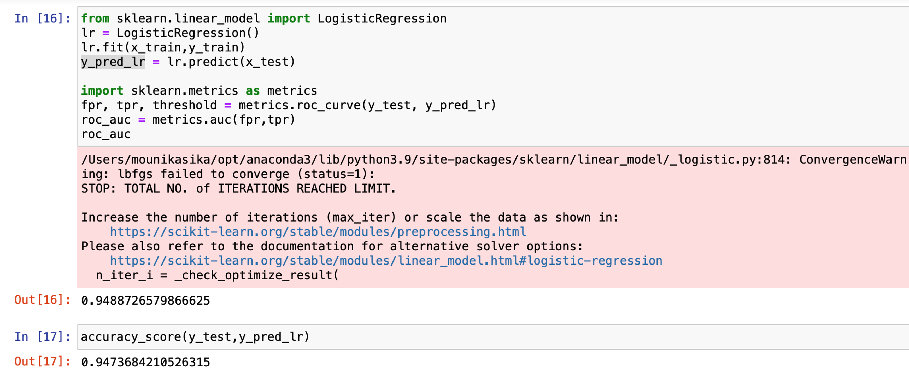
We are seeing an accuracy of 94.78% with the logistic regression algorithm.

Slide 13
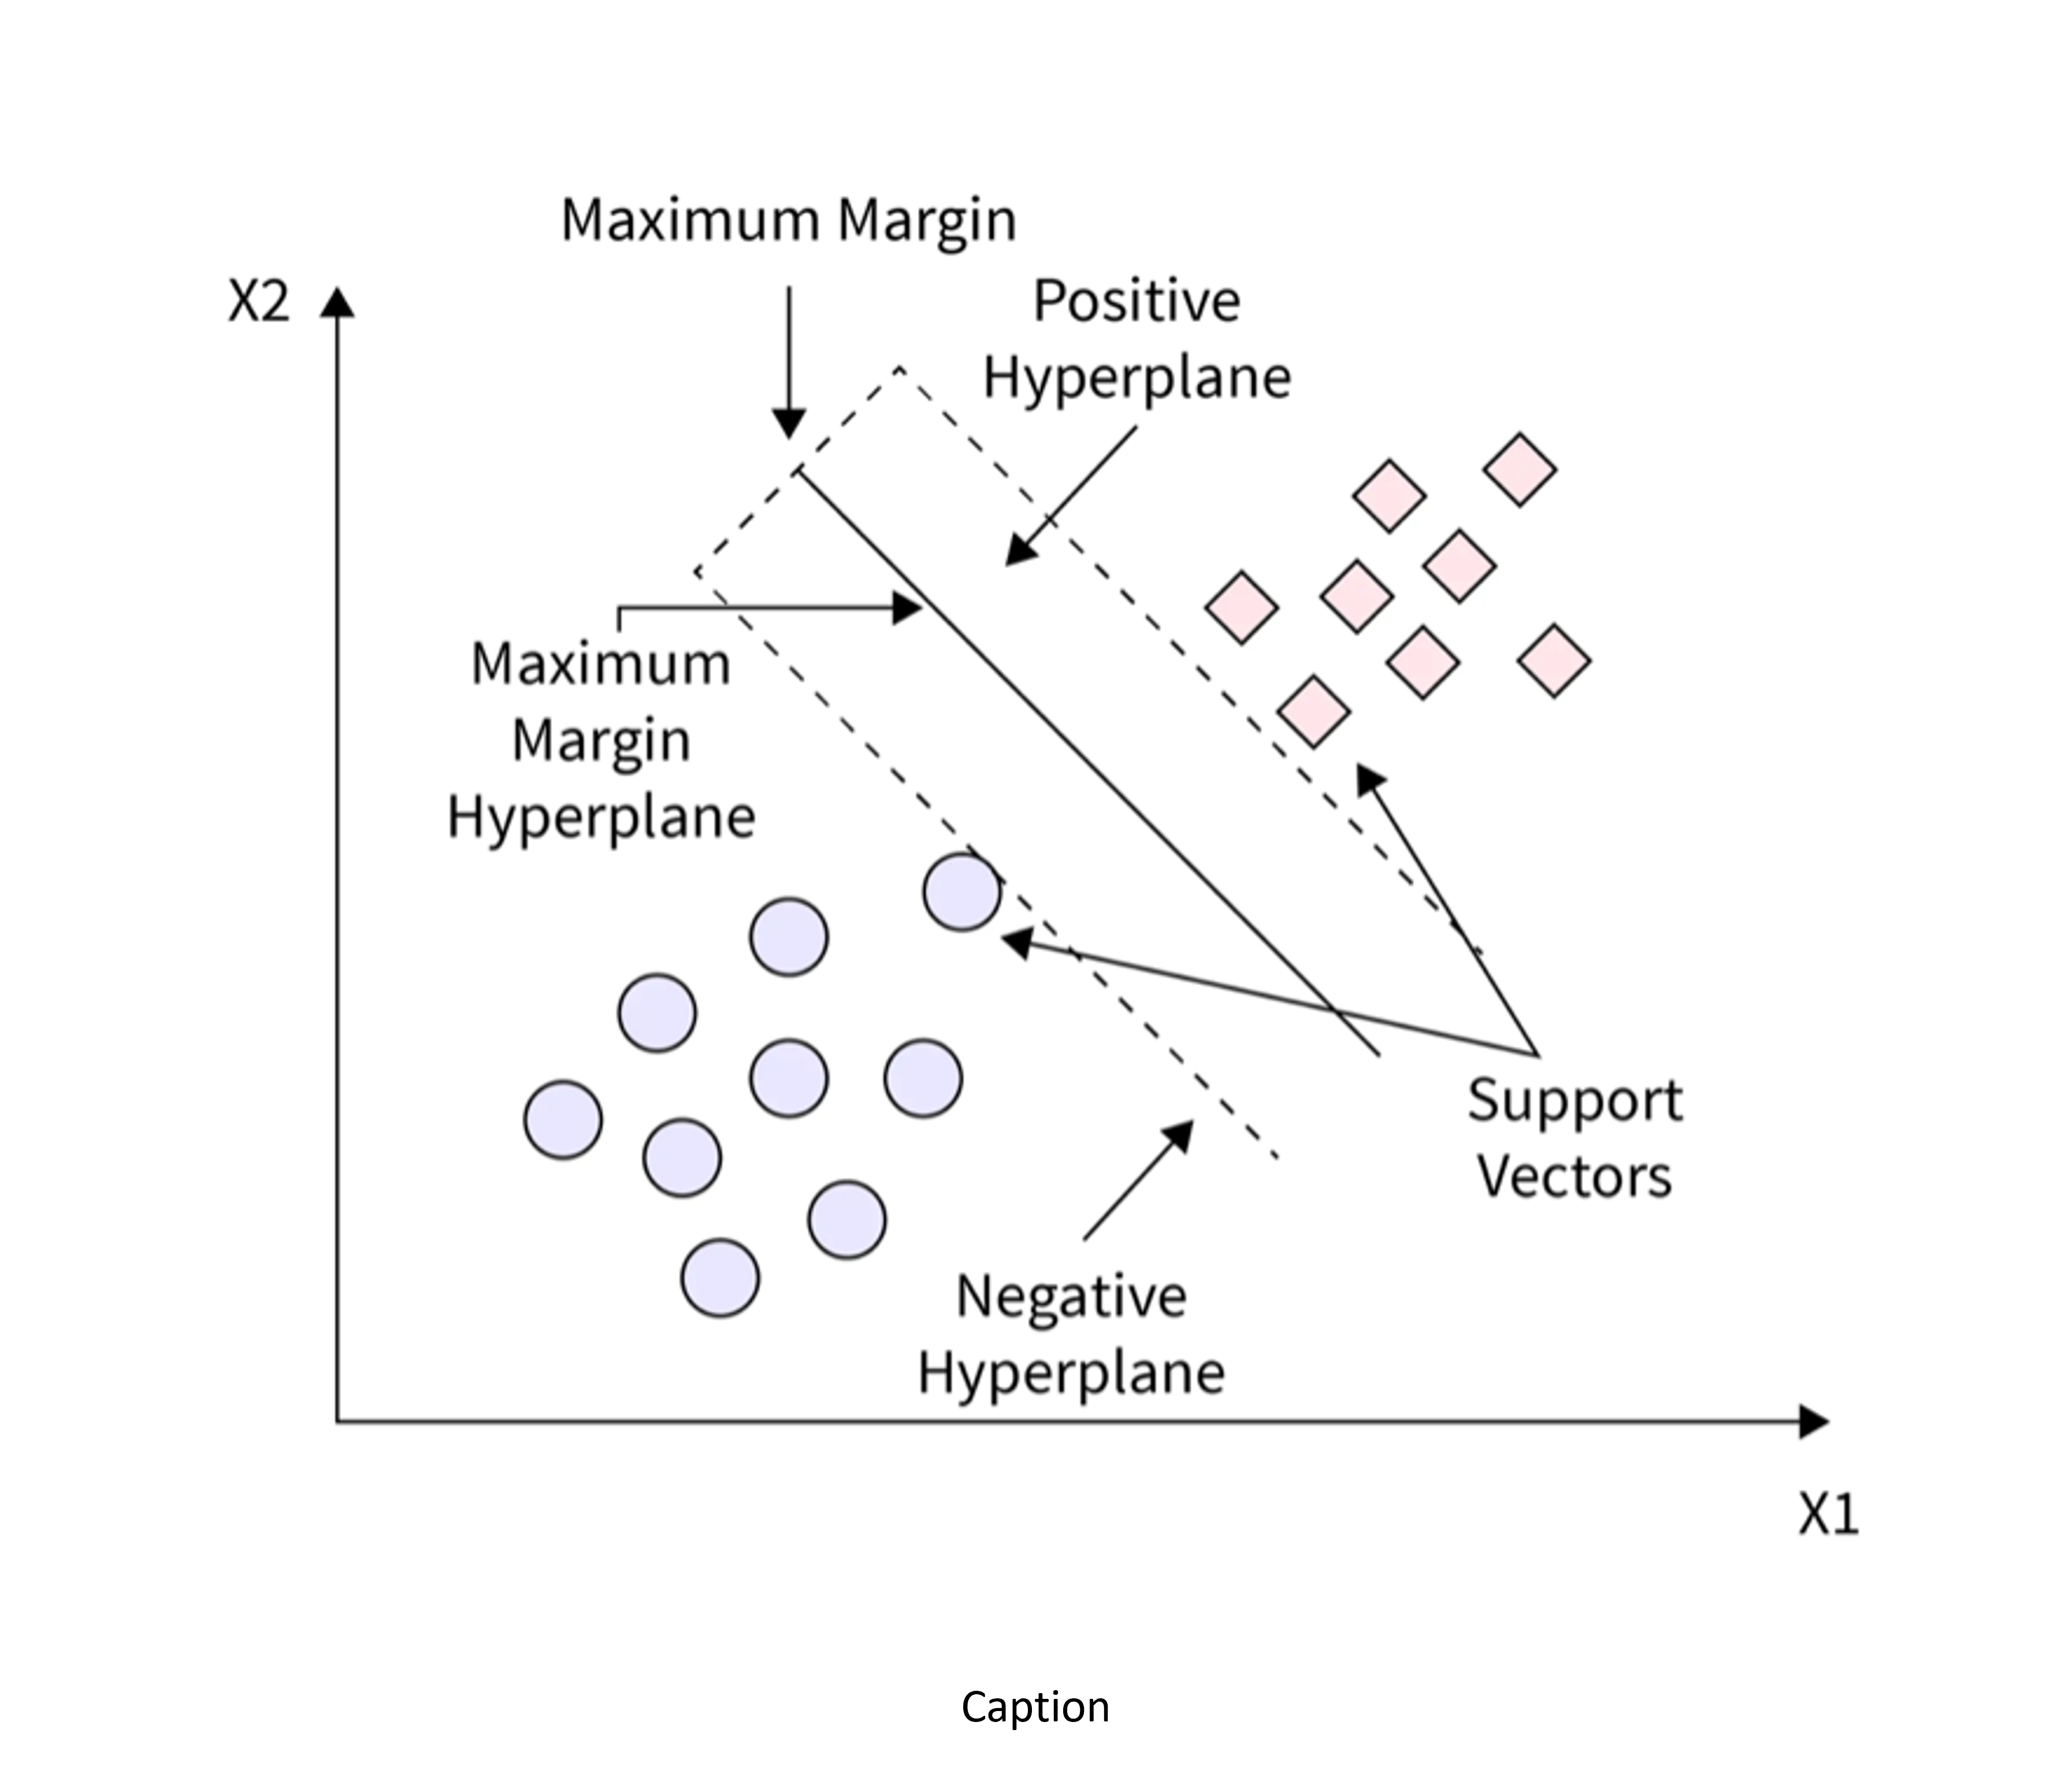
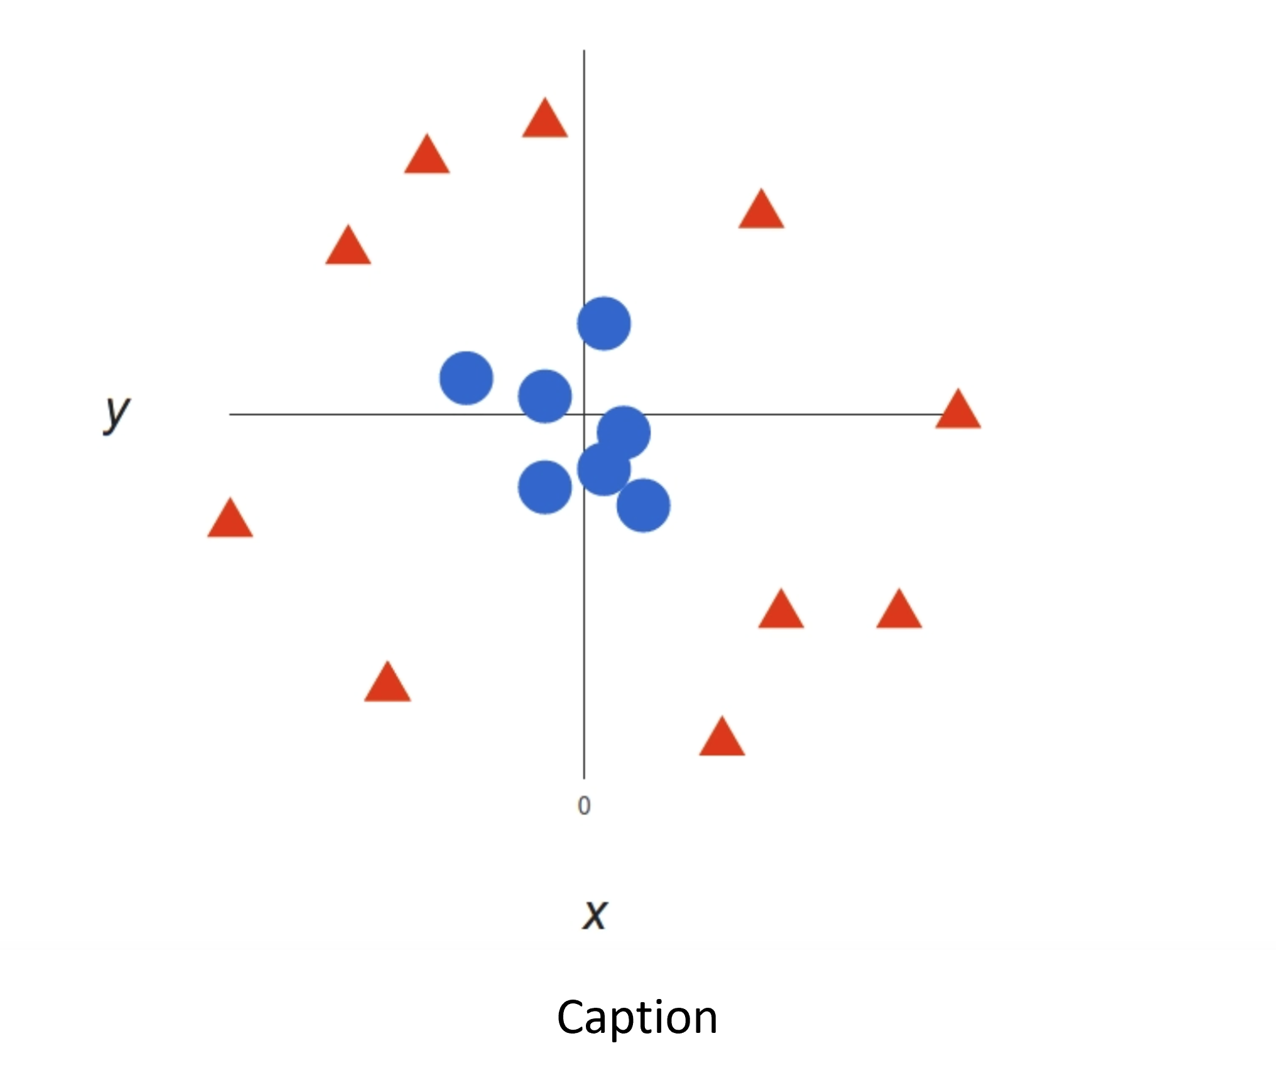
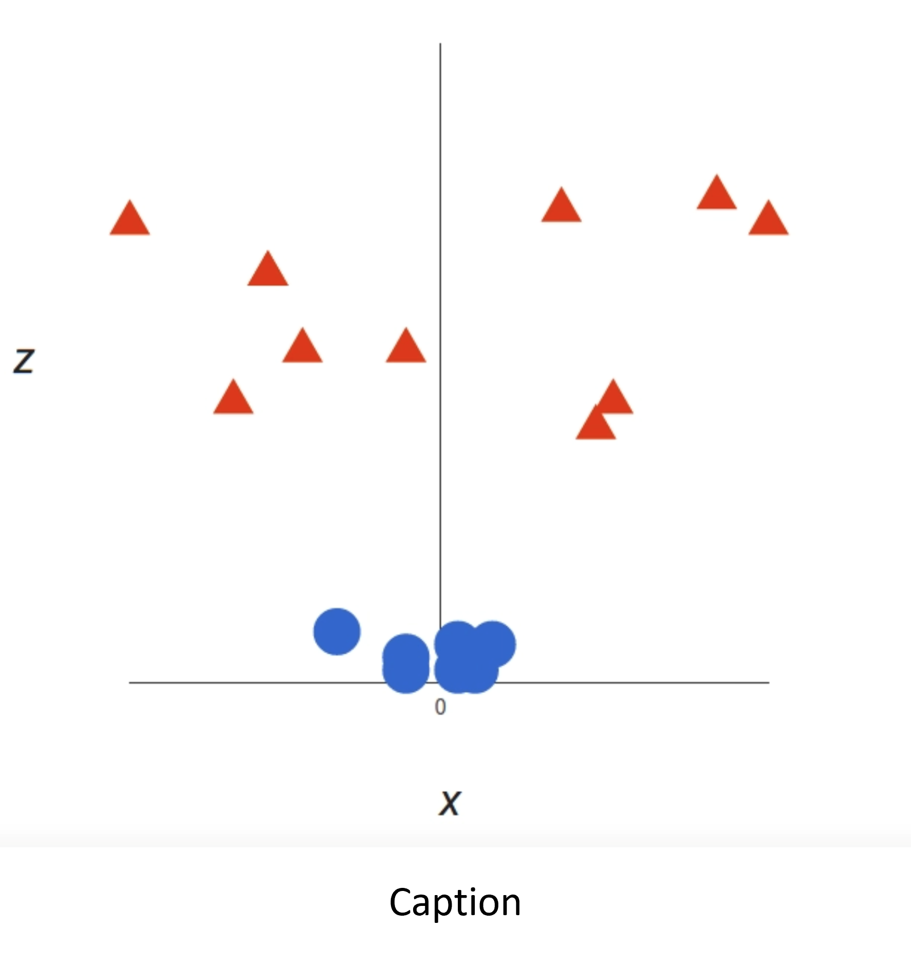
Support Vector Machine (SVM)
SVM is another supervised learning algorithm.
SVM takes the input and gives a hyperplane that best separates the data of the two classes. Also called Decision Boundary.
SVM tries to create the best hyperplane.
SVM can be used for non-linear data as well.
We can create a 3rd dimension with which we should be able to draw a hyper plane between the data points.

Slide 14
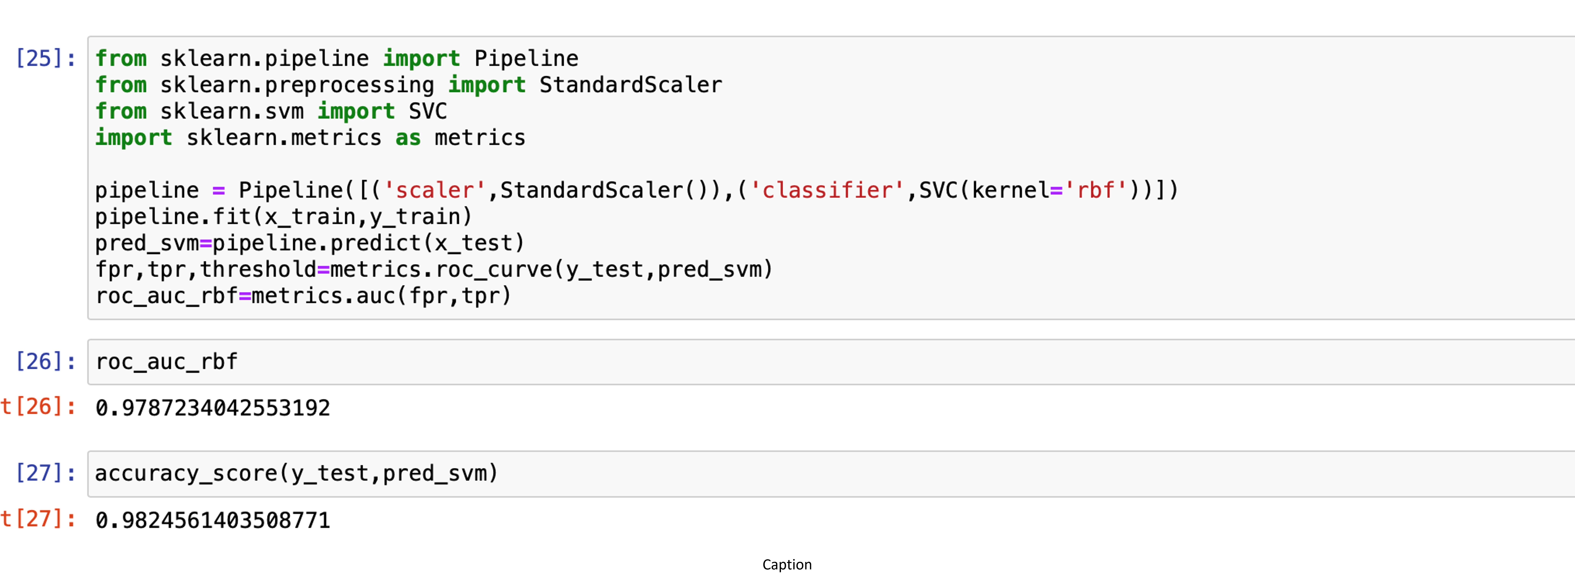
The SVM algorithm has an accuracy of 98.24% which is the maximum of the four algorithms.

Slide 15
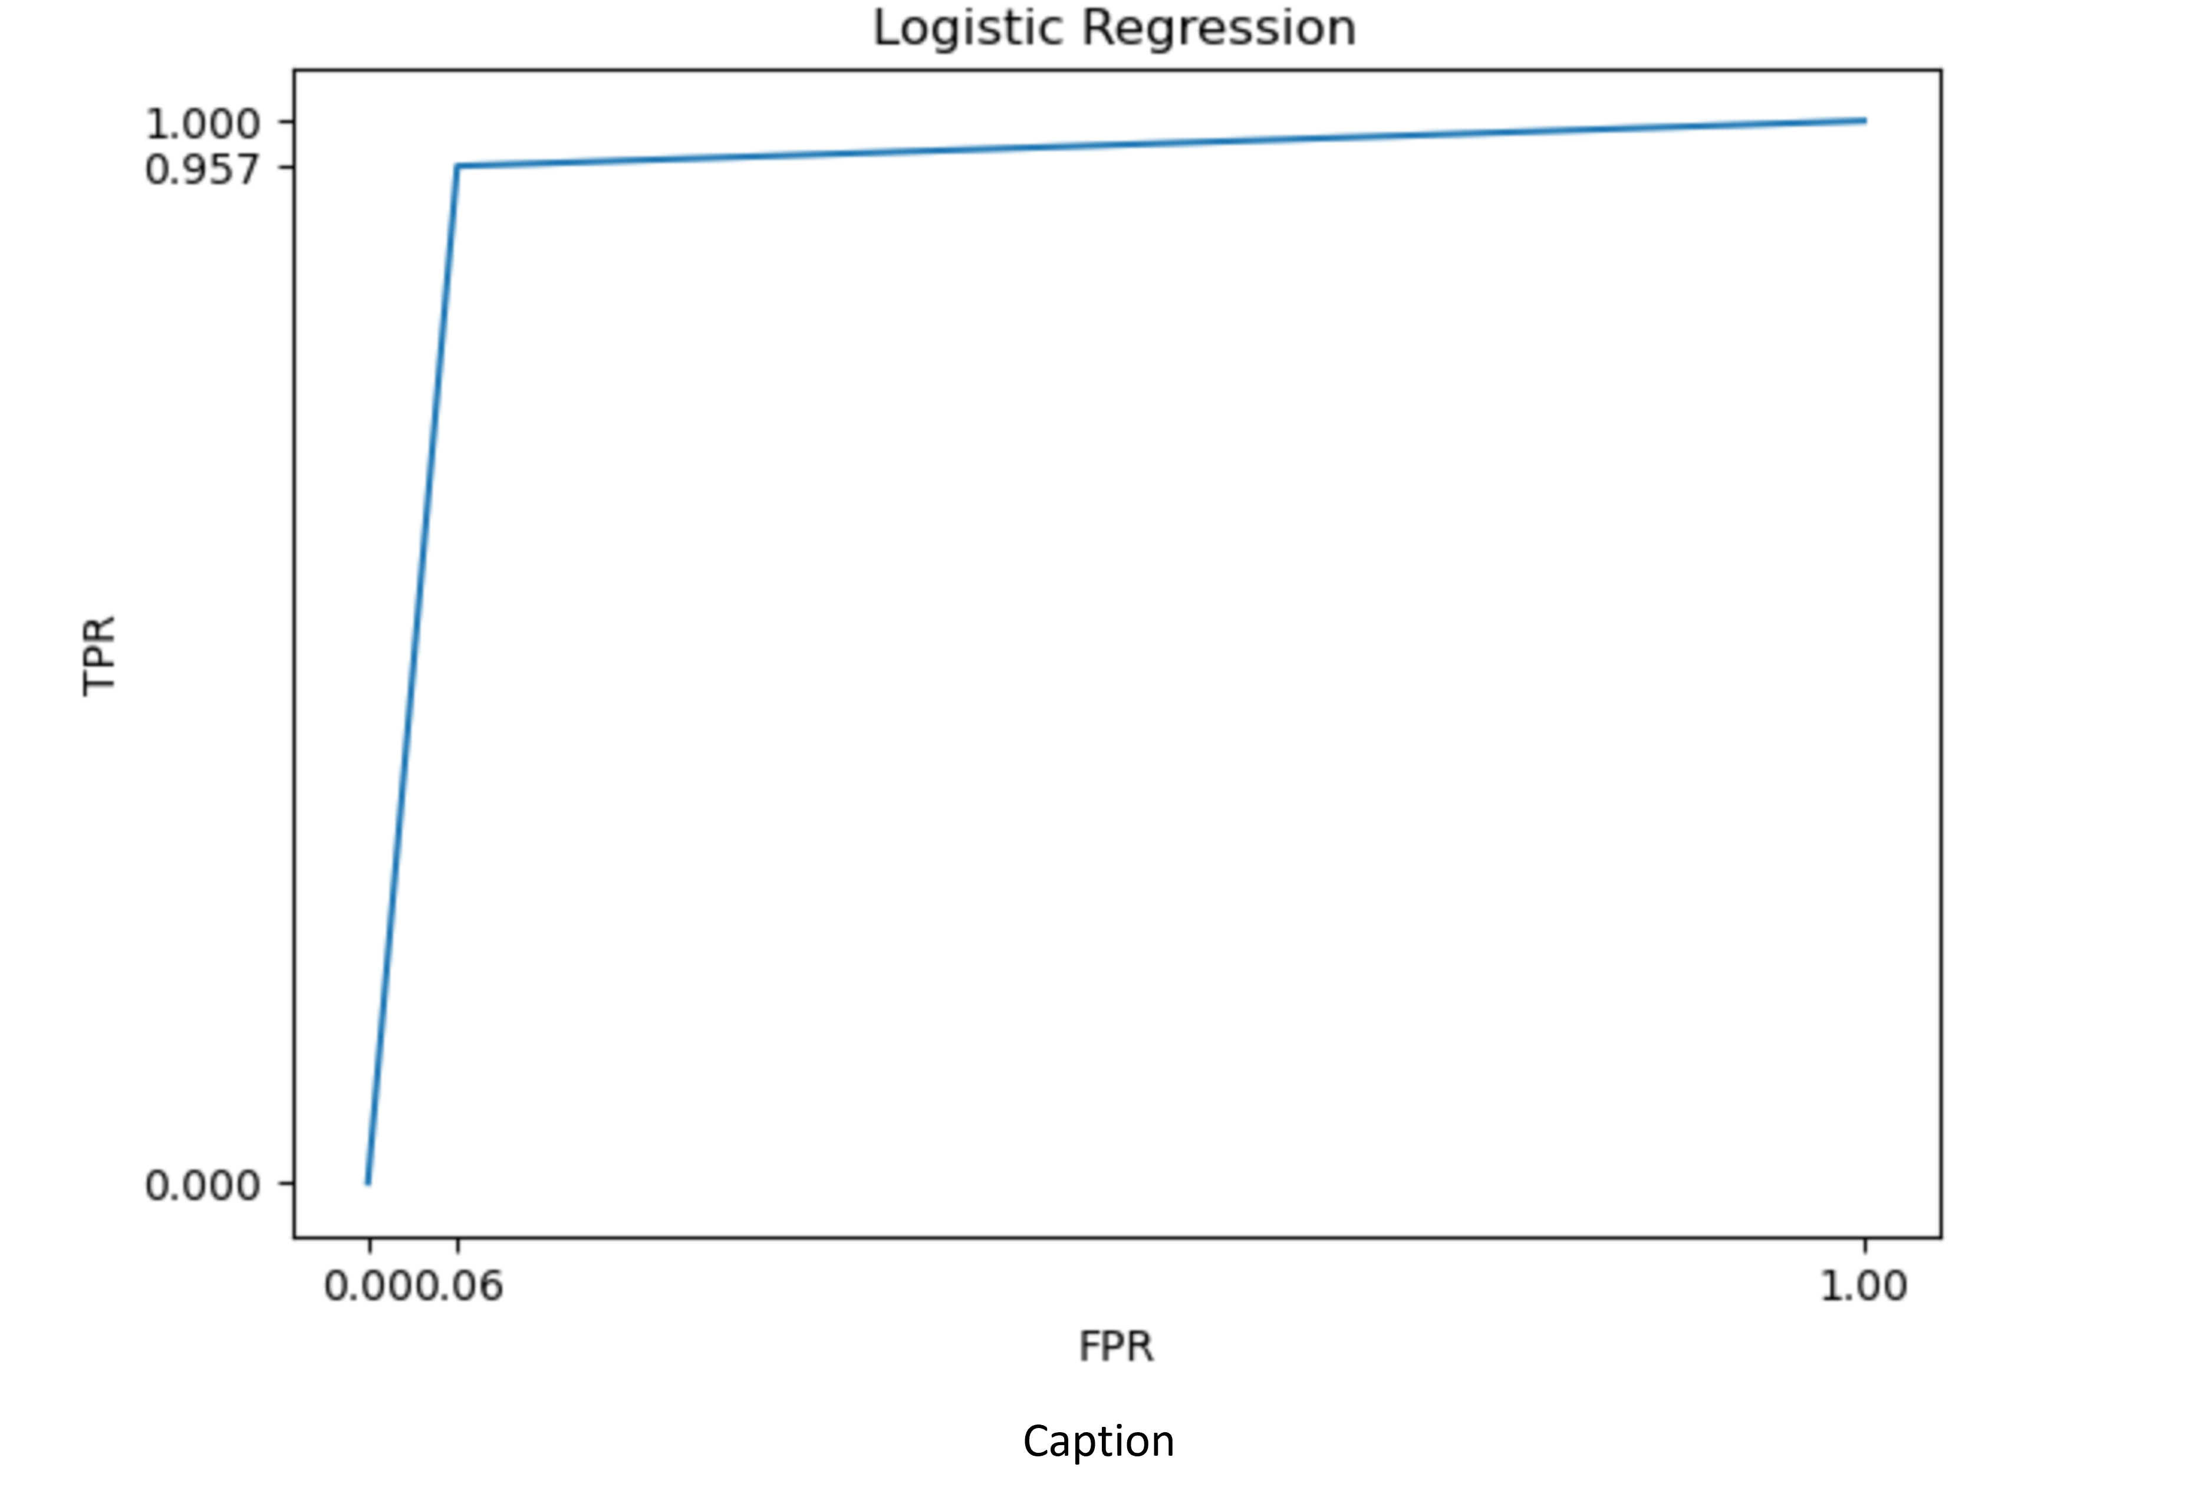
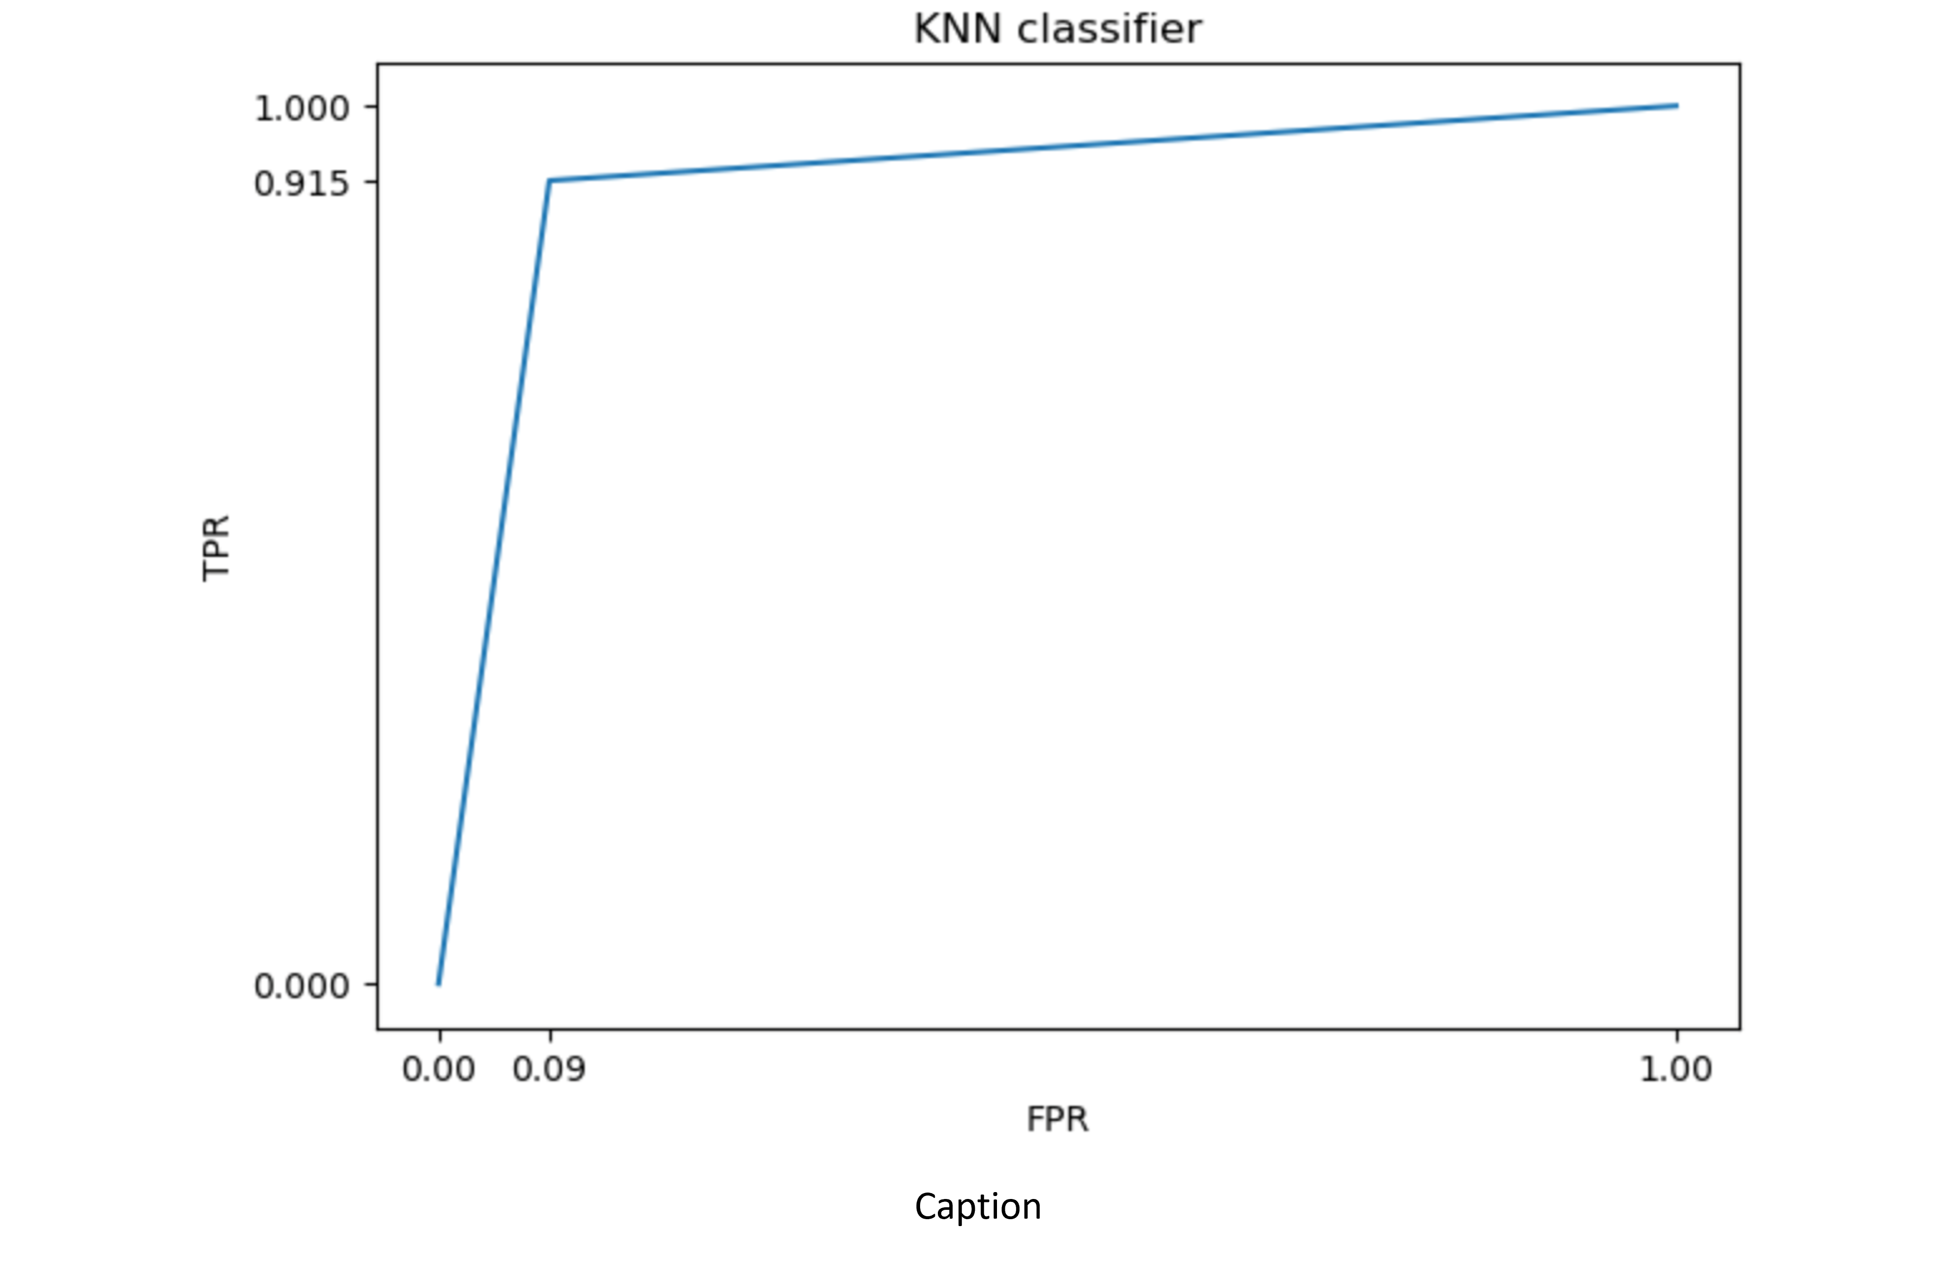
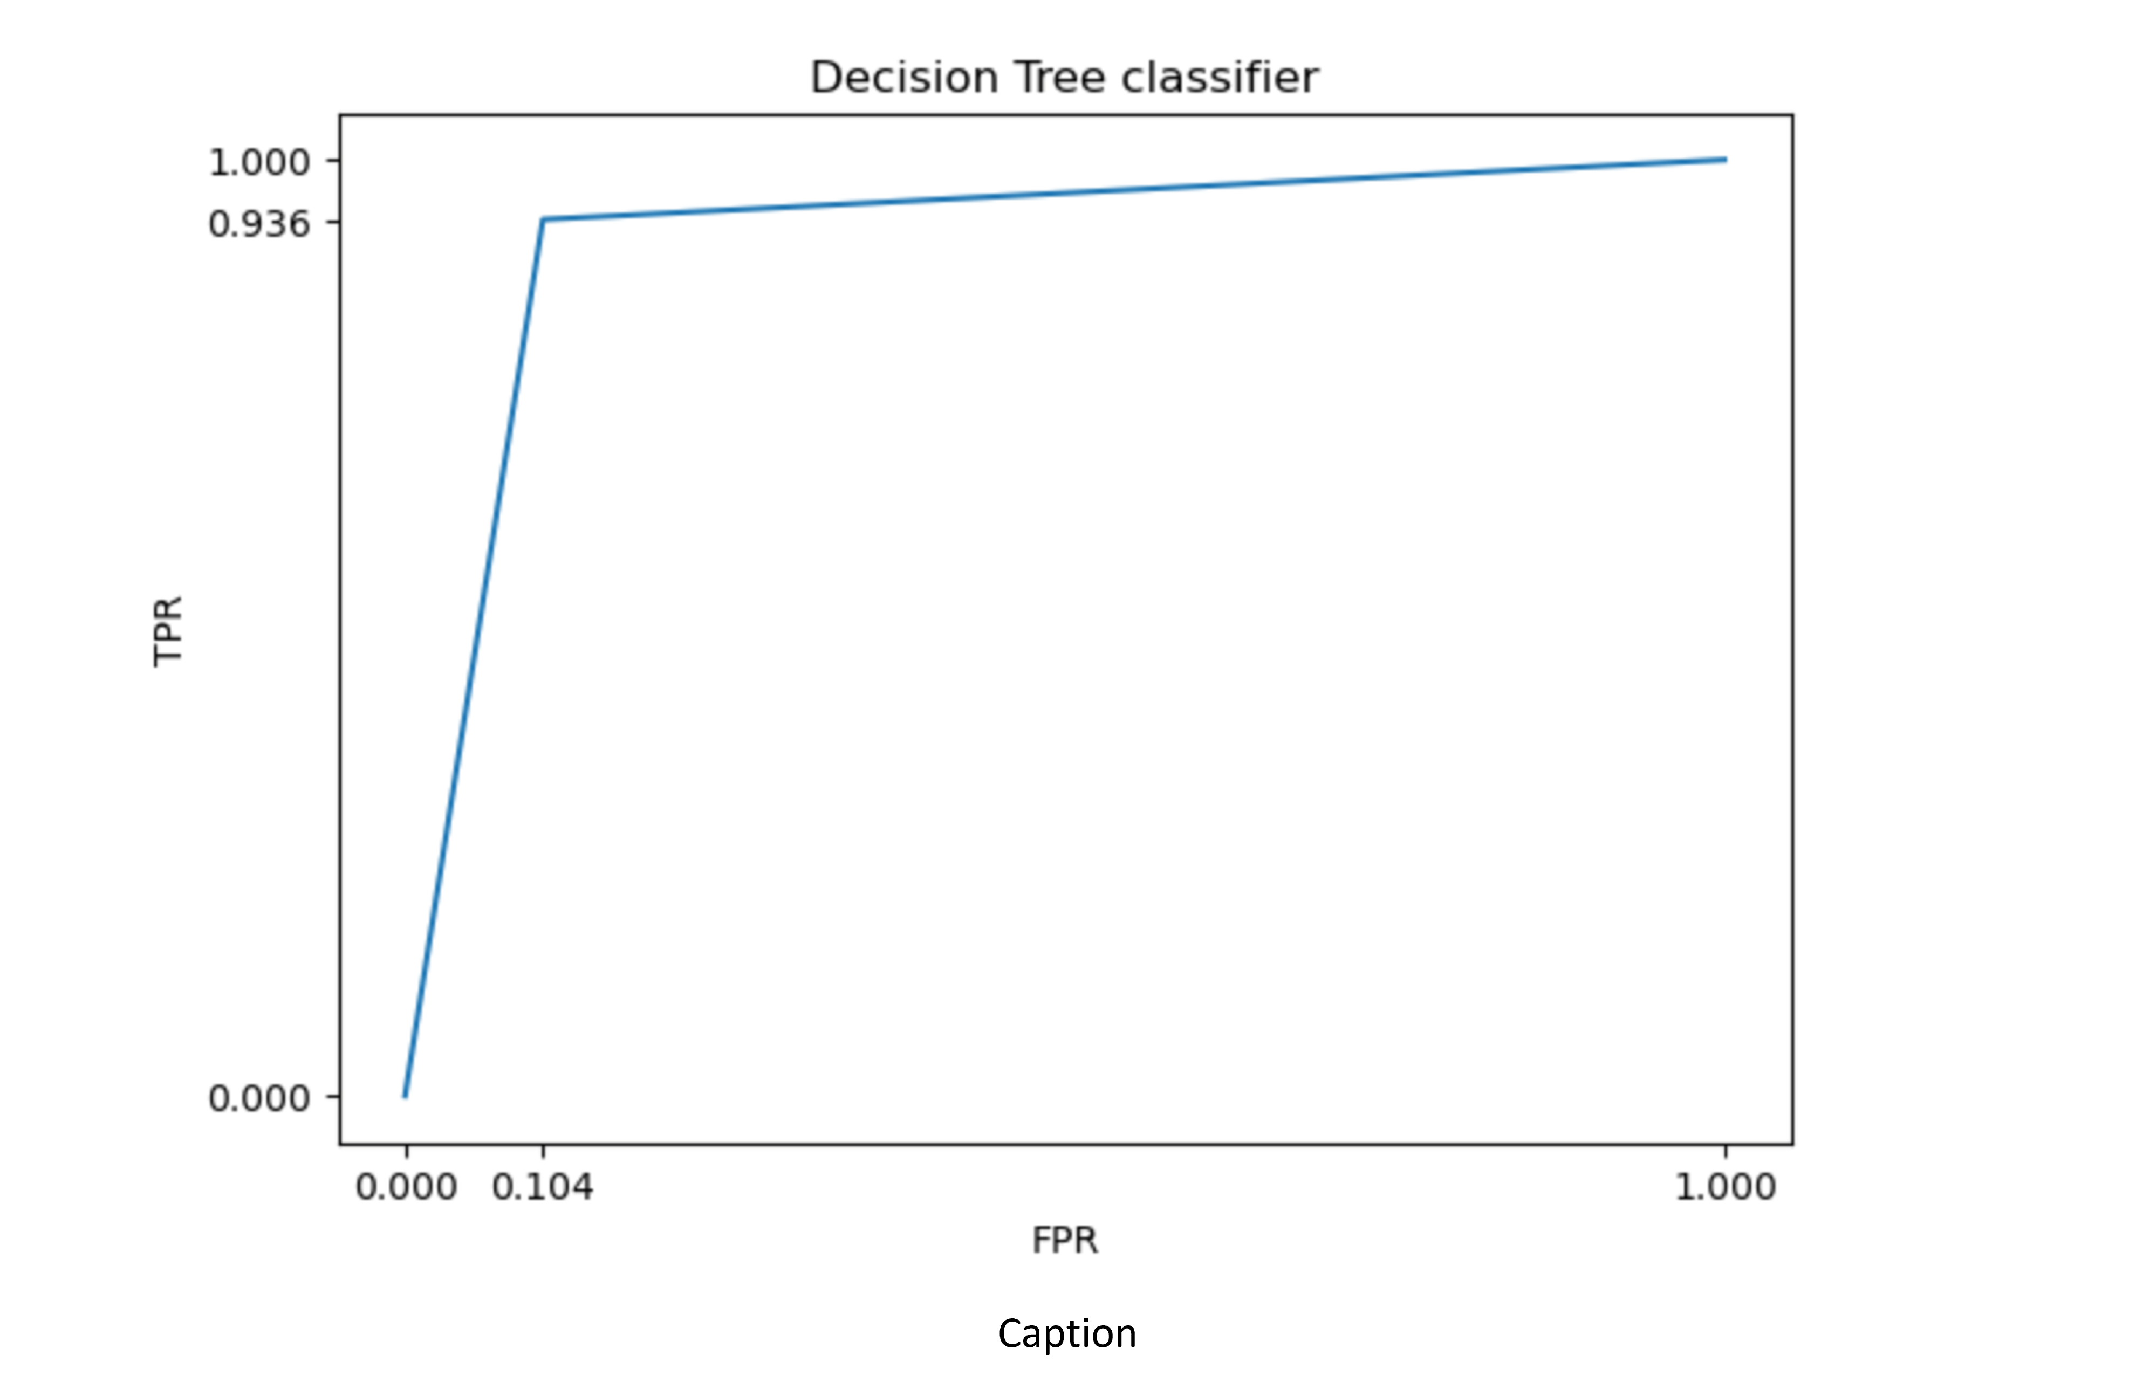
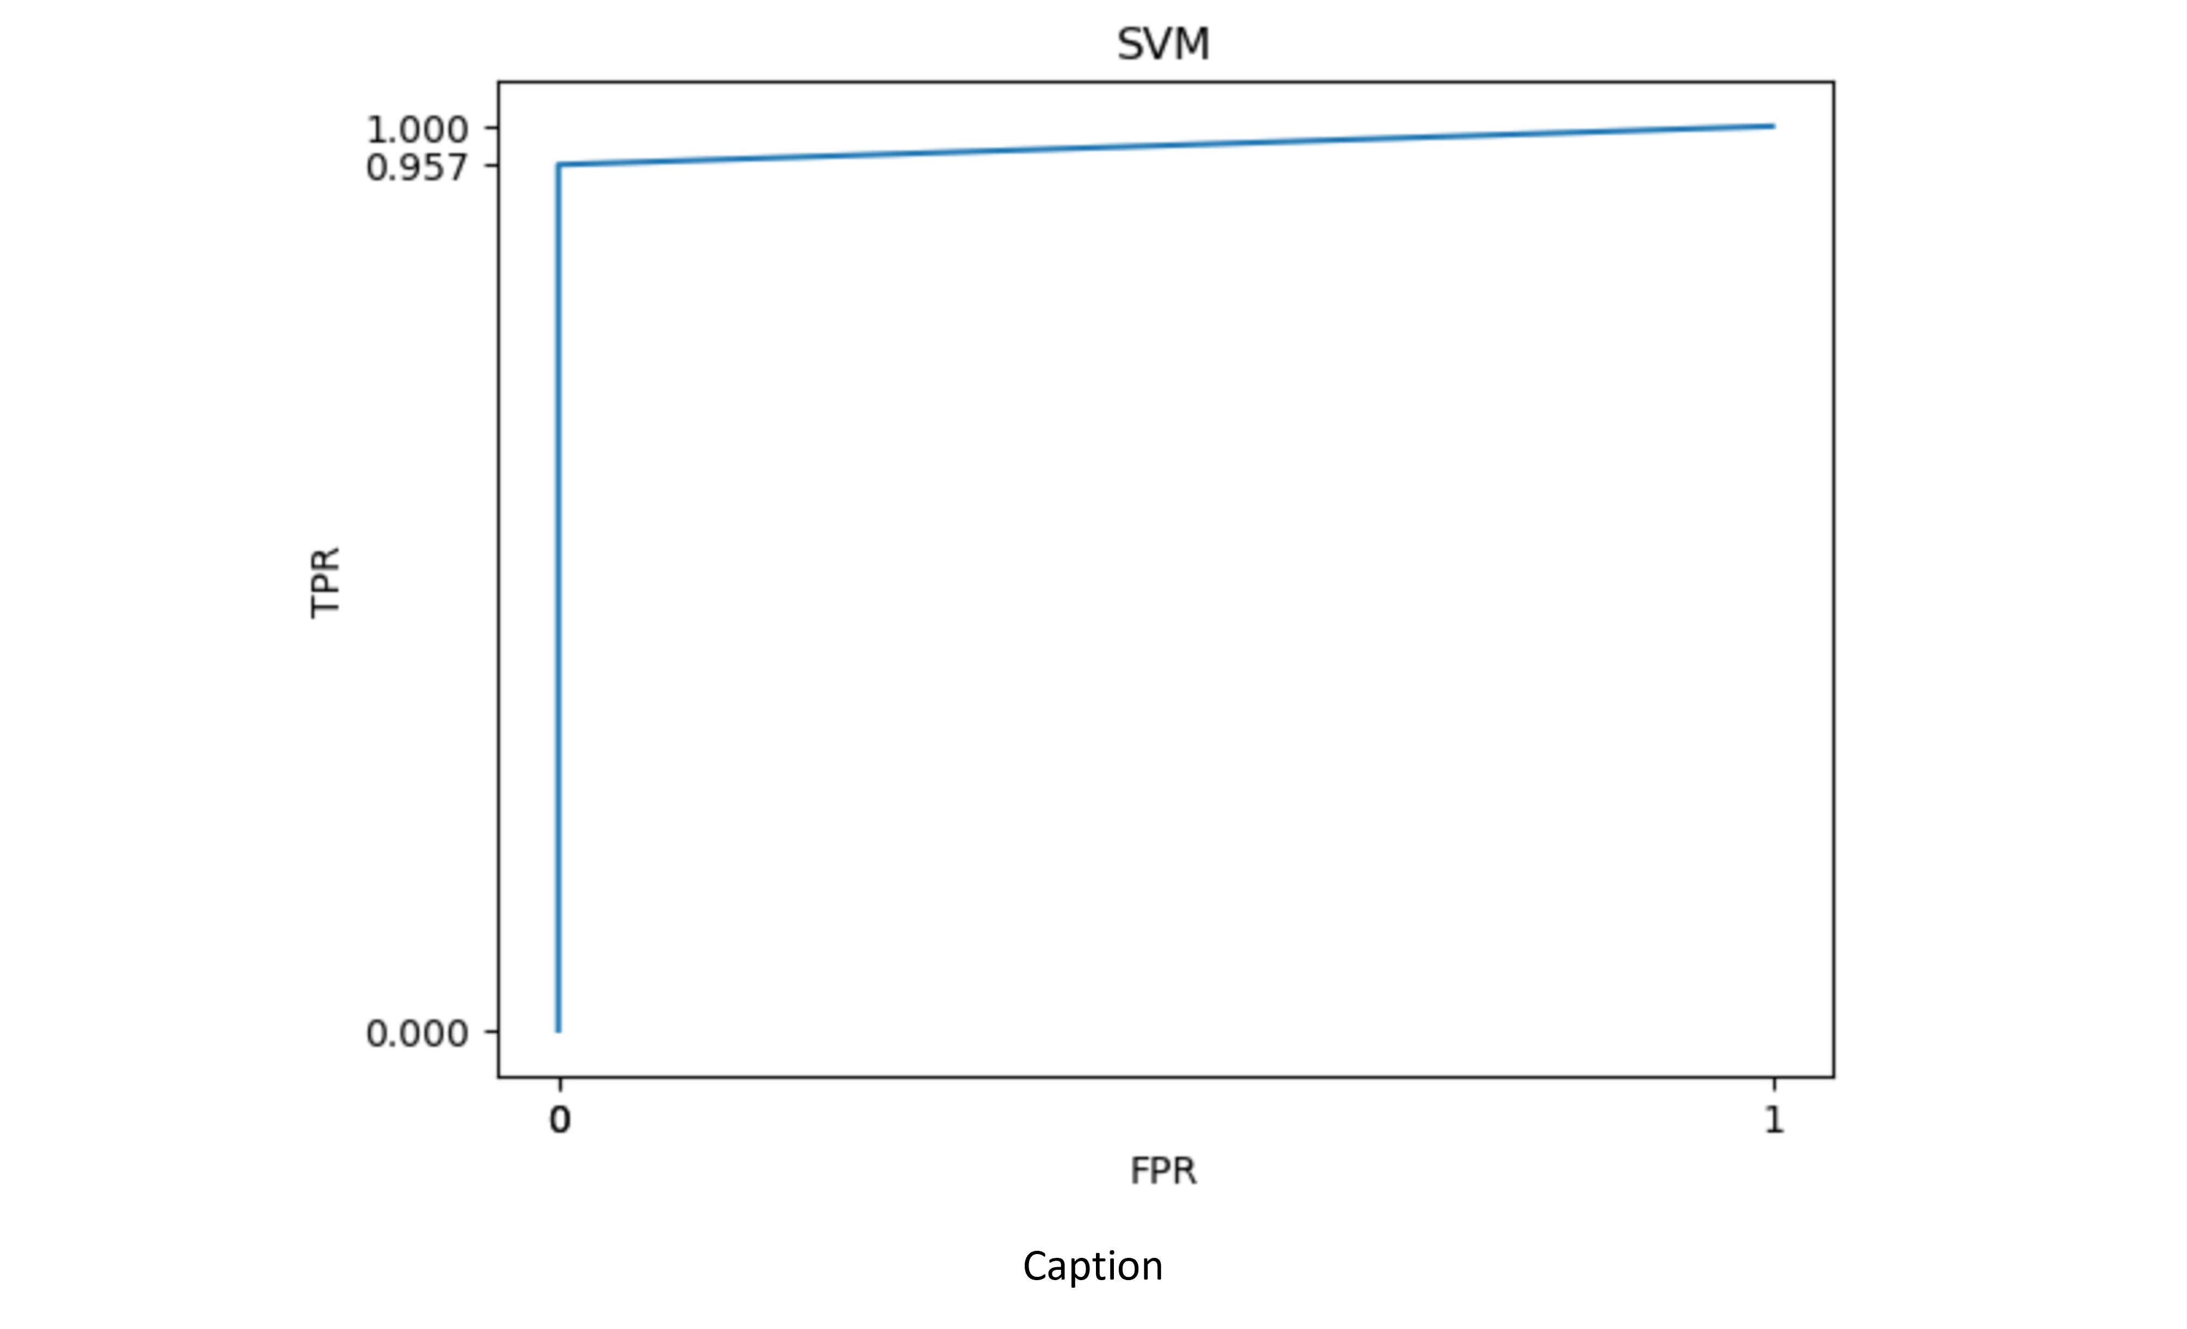

Slide 16
References
Deepika Verma(M. Tech Scholar), Dr. Nidhi Mishra(AssociateProfessor), Poornima University Jaipur, India, “Analysis and Prediction of Breast cancer and Diabetes disease datasets using Data mining classification Techniques”, IEEE Xplore Compliant – Part Number:CFP17M19-ART, ISBN:978-1-5386-1959-9, pp. 533-538.
Vikas Chaurasia1, Saurabh Pal1 and BB Tiwari2, “Prediction of benign and malignant breast cancer using data mining techniques”, Journal of Algorithms & Computational Technology 2018, Vol. 12(2) 119–126 ! The Author(s) 2018,pp. 119-126.
Nidhi Mishra, Naresh Khuriwal “Breast cancer diagnosis using adaptive voting ensemble machine learning algorithm”, 2018 IEEMA Engineer Infinite Conference (TechNxT), 2018
What Is Breast Cancer? — CDC”, CDC, 2020. [Online]. Available: https://www.cdc.gov/cancer/breast/basic info/what-is-breastcancer.htm. [Accessed: 01- Feb- 2020].

Slide 17
THANK YOU

